Slide 1


Health Insurance Marketplace Analysis: Cost, Competition, and Coverage Disparities
Tennessee vs. U.S. Market
Aveen Brifcany

Slide 2
Overview
This project analyzes how marketplace structure and plan pricing relate to insurance coverage disparities in the United States.
I compare Tennessee’s marketplace to the national market and examine how costs may influence uninsured populations, particularly across income and gender groups.
Notes:
Slide 2 – Research Question & Data
How Do Plan Costs and Market Structure Relate to Insurance Disparities?
The main research question guiding this project is:
How do plan costs and market structure influence insurance coverage gaps?
I used CMS Marketplace Plan Attributes and Rate Public Use Files to analyze insurer participation and premium costs.
I also used ACS table B27001 to examine uninsured rates by gender and income-related coverage patterns.
All data were cleaned, merged, and analyzed in Python.

Slide 3
Research question & data
The main research question guiding this project is: how do plan costs and market structure influence insurance coverage gaps?
I used CMS marketplace plan attributes and rate public files to analyze insurer participation and premium costs.
I also used ACS table B27001 to examine uninsured rates by gender and income-related coverage patterns.
All data were cleaned, merged, and analyzed in python & Excel.

Slide 4
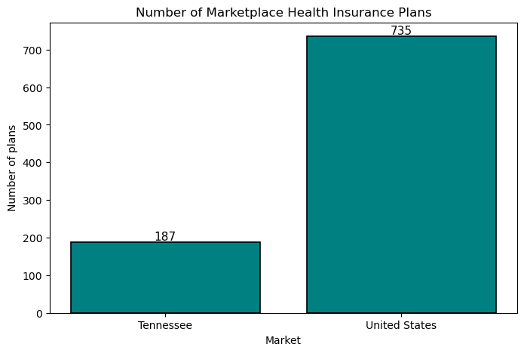
Insurer Participation: Tennessee vs. National Market
Tennessee 187
United States 735
Tennessee Shows More Limited Insurer Competition
Fewer participating insurers may reduce competitive pricing pressure.
Notes:
Slide 3 – Marketplace Competition
Tennessee Has More Limited Insurer Participation
This slide compares insurer participation in Tennessee versus the national marketplace.
The results show that Tennessee has fewer participating insurers compared to the national market.
Reduced insurer participation can limit consumer choice and may reduce competitive pressure on premiums.
While availability exists, competition levels differ across markets.

Slide 5
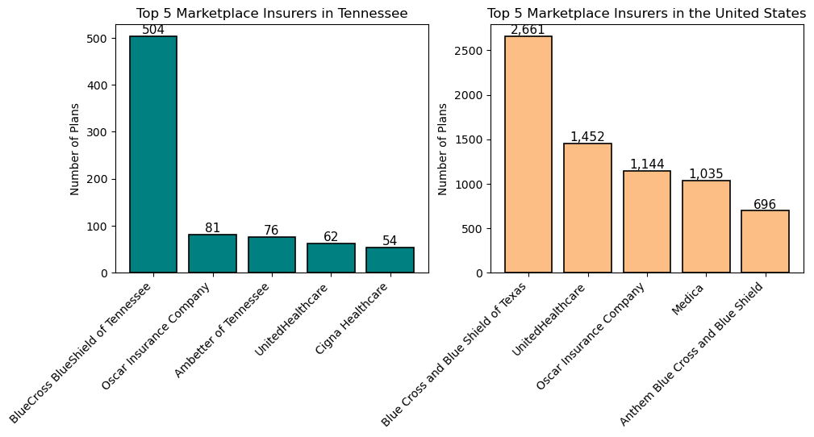
The Tennessee marketplace offers significantly fewer health insurance plans compared to the national market. This suggests that consumers in Tennessee may face more limited plan choices than consumers nationwide.
FIRST TO MARKET
TESTED
Conducted testing with college students in the area
AUTHENTIC
Designed with the help and input of experts in the field
Notes:
Additionally, the competition in both markets is highly limited.
In Tennessee and in other states, Blue Cross Blue Shield holds most of the plan offerings.
This limited competition creates little incentive to lower prices.

Slide 6
Percentage of available plan types
United States
Tennessee
Metal level
Silver 46.73%
Gold 21.62%
Expanded Bronze 21.14%
Low 3.66%
Bronze 2.66%
High 2.64%
Platinum 0.88%
Catastrophic 0.68%
Metal level
Silver | 50.23%
Expanded Bronze | 20.83%
Gold | 14.81%
Bronze | 8.33%
Low | 3.36%
High | 1.97%
Platinum | 0.47%
Both Tennessee and US plans are primarily silver level
Notes:
Here we see that the majority of plans offered are Silver or higher, with very few companies offering lower, cheaper plans.

Slide 7
Metal Level Overview
Plan Category: | Plan pays: | You pay: | Deductible is generally:
Bronze | 60% | 40% | High
Silver | 70% | 30% | Moderate
Gold | 80% | 20% | Low
Platinum | 90% | 10% | Low
Health plan categories: Bronze, Silver, Gold, & Platinum | HealthCare.gov
Notes:
Here is an overview of the different metal levels . Bronze has the highest deductibles and the highest copay rates. As you move towards platinum, your copay improves and your deductible decreases.

Slide 8
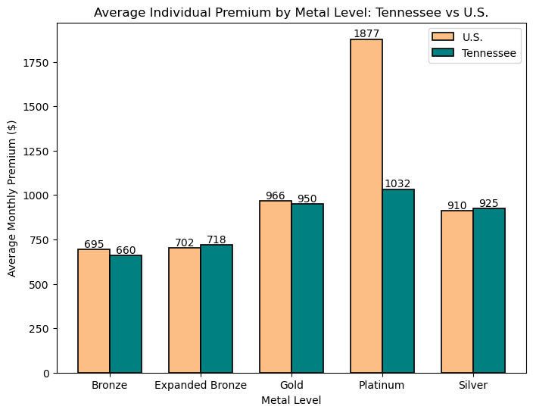
Metal level premiums are similar for us plans when compared to TN plans, except for platinum level plans
Notes:
Here we see average premiums by metal level.
Bronze plans are the least expensive but offer lower coverage protection.
As we move to Silver, Gold, and Platinum, premiums increase a lot.
Also, the cheapest plans sit at well over 500 dollars a month.
This shows a clear tradeoff: higher coverage comes at a substantially higher monthly cost.
For many individuals, especially lower-income households, higher-tier plans may not be financially feasible.

Slide 9
General health insurance plans did not cover dental for adults (some plans offered limited pediatric dental coverage). Purchasing health insurance with additional dental costs an average of an additional $57 dollars.”
United States
Tennessee
Plan Type | Count (avg. over states) | Average Premium
Main Coverage | 207578 | $890
Dental Only | 31547 | $57
Plan Type | Count | Average Premium
Main Coverage | 115923 | $865
Dental Only | 17748 | $19
Notes:
These plans do not include dental.
Dental adds additional cost to monthly premiums.
Luckily, Tennessee is well below the average dental premium than other states.

Slide 10
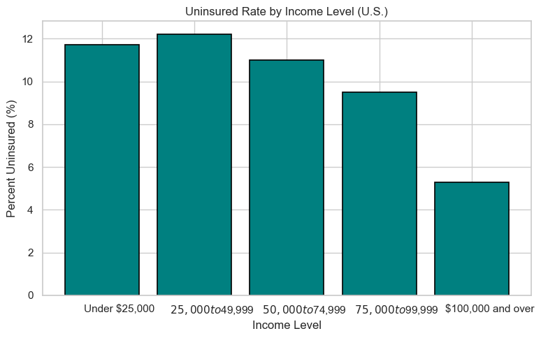
Uninsured rates by income bracket
Uninsured rates are high for individuals who make less than 74k annually
Notes:
Slide 5 – Income & Coverage Gaps
Uninsured Rates Are Highest Among Lower-Income Groups
This slide highlights uninsured rates across income-related groups.
The story is very clear: uninsured rates are highest among lower-income populations and decrease as income increases.
This suggests that affordability plays a major role in determining coverage status.
Even when plans are available, cost may remain a barrier.

Slide 11
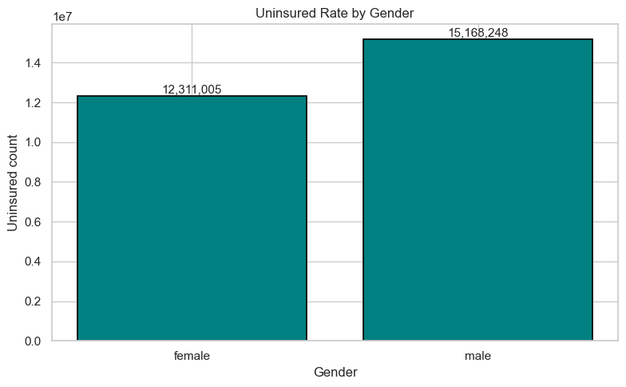
Men are more likely to be uninsured than women.
gender estimate
female 12311005
male 1516824
Notes:
Gender Comparison
Gender Differences Exist, But Are Smaller Than Income Gaps
Here we examine uninsured rates by gender.
There are measurable differences between males and females.
However, the magnitude of this difference is smaller compared to income-based disparities.
This indicates that economic factors are stronger predictors of coverage gaps than gender alone.

Slide 12
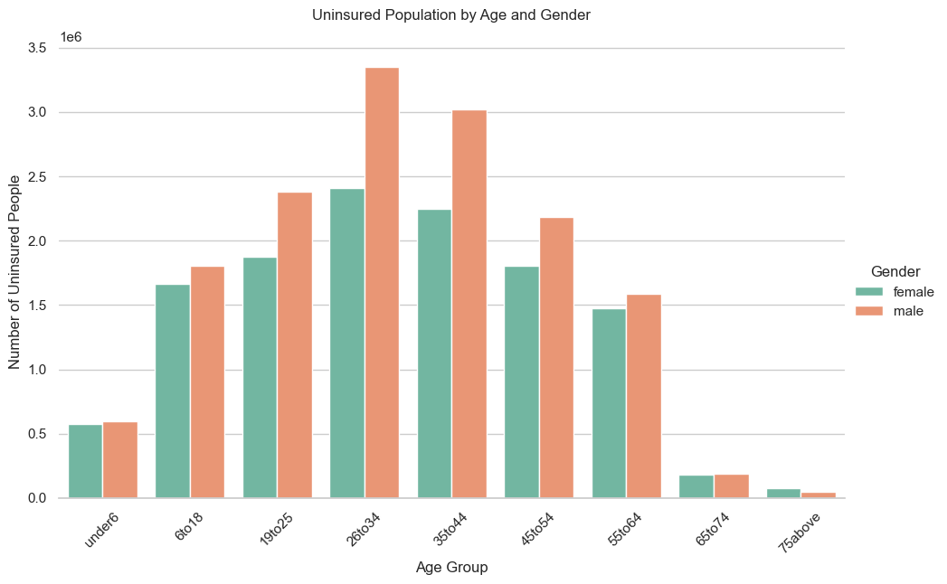
Specifically, men in their late 20s to early 30s are less likely to be insured than women of the same age
Notes:
Gender comparison details:
We can see from this graph that the differences in gender are primarily with young adults.
Young adults typically make less than their older counterparts.
This graph shows why affordability is the number one reason for uninsured rates.

Slide 13

Key Patterns Across Findings
Affordability Emerges as the Central Barrier
Marketplace competition influences plan pricing.
Plan pricing directly affects affordability.
Affordability strongly impacts uninsured rates.
Lower-income individuals are the most sensitive to premium costs.
Notes:
Slide 7 – Key Patterns Across Findings
Affordability Emerges as the Central Barrier
When we combine all findings, a consistent pattern emerges.
Marketplace competition influences plan pricing.
Plan pricing affects affordability.
And affordability strongly affects uninsured rates.
The most effected groups are younger, lower-income individuals, who are most sensitive to premium costs.

Slide 14
Conclusion
Cost and income drive coverage disparities in the marketplace
Coverage gaps are primarily driven by premium affordability, not just plan availability.
Income is the strongest predictor of who remains uninsured.
Demographic differences exist, but their effects are secondary to income and cost barriers.
Improving affordability and maintaining marketplace competition could significantly reduce uninsured rates.
Notes:
Slide 8 – Final Conclusion
Cost and Income Drive Coverage Disparities in the Marketplace
In conclusion, plan availability alone does not guarantee access to coverage.
Premium affordability remains the strongest driver of insurance disparities.
While demographic differences exist, income plays the most significant role in determining who remains uninsured.
These findings suggest that policies focused on improving affordability and maintaining marketplace competition may help reduce coverage gaps.

Slide 15


